Slide 1
2. Heteroscedasticity
from hetero- + scedastic, from Greek skedasis - a scattering/ dispersal
Heteroscedasticity refers to situations where the variance of the residuals is unequal over a range of measured values.
When running a regression analysis, heteroskedasticity results in an unequal scatter of the residuals (or the error term)

Slide 2
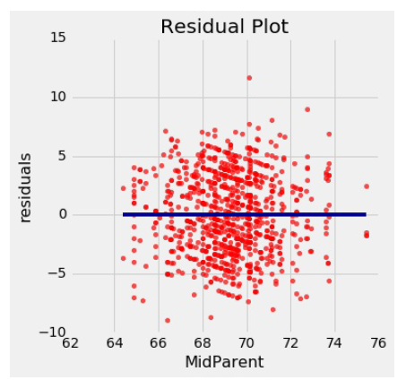
Residuals in Linear Regressions
A residual plot can be drawn by plotting the residuals against the predictor variable
Notice that the plot appears to be centered around the horizontal line at the level 0 (shown in dark blue).
Notice also that the plot shows no upward or downward trend. …. that this is true of all regressions.
The residual plot of a good regression shows no pattern.
The residuals look about the same, above and below the horizontal line at 0, across the range of the predictor variable.

Slide 3
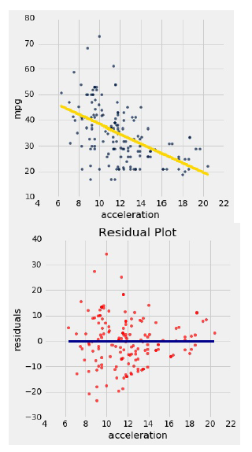
Detecting Heteroscedasticity("uneven spread“).
Data on hybrid cars in the U.S. Here is a regression of fuel efficiency on the rate of acceleration. The association is negative: cars that accelerate quickly tend to be less efficient.
Notice how the residual plot flares out towards the low end of the accelerations i.e, variability in the size of the errors is greater for low values of acceleration than for high values.
Uneven variation is often more easily noticed in a residual plot than in the original scatter plot.
If the residual plot shows uneven variation about the horizontal line at 0, the regression estimates are not equally accurate across the range of the predictor variable.

Slide 4

Heteroscedasticity
A critical assumption of the classical linear regression model is that the residuals have all the same variance, σ ² .
When this condition holds, the error terms are homoscedastic, which means the errors have the same scatter regardless of the value of X.
When the scatter of the errors is different, varying depending on the value of one or more of the independent variables, the error terms are heteroscedastic.

Slide 5

HETEROSCEDASTICITY
One of the assumptions of the classical linear regression (CLRM) is that the variance of u_{i}, the error term, is constant, or homoscedastic.
Reasons for ~:
The presence of outliers in the data
Incorrect functional form of the regression model
Incorrect transformation of data
Mixing observations with different measures of scale (such as mixing high-income households with low- income households)

Slide 6

Implications of ~
Heteroscedasticity implies that the variances (i.e. - the dispersion around the expected mean of zero) of the residuals are not constant, but that they are different for different observations.
This causes a problem: if the variances are unequal, then the relative reliability of each observation (used in the regression analysis) is unequal.
The larger the variance, the lower should be the importance (or weight) attached to that observation.

Slide 7

CONSEQUENCES OF HETEROSCEDASTICITY
Ordinary least squares estimators not efficient.
Usual formulas give incorrect standard errors for least squares.
Confidence intervals and hypothesis tests based on usual standard errors are wrong.
If we still use OLS in the presence of heteroscedasticity, our standard errors could be inappropriate and hence any inferences we make could be misleading

Slide 8
Thank You…

